Slide 1

God Saw Everything He Had Made, and Behold, It Was Very Good!

Slide 2
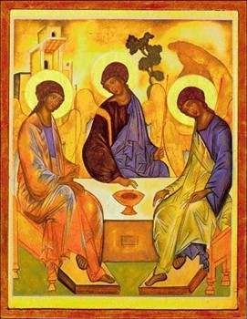

Key Terms:
Trinity
Image and Likeness of God
Father
Man
Holy Spirit
Baby
Son
Woman

Slide 3
Loving as God Loves
FREE
+
TOTAL
+
FAITHFUL
+
FRUITFUL
=
MARRIAGE

Slide 4

God Gave Us Capacity to Choose

Slide 5

Entrance of Shame

Slide 6
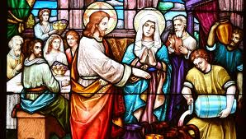
Christ Restores God’s Plan for Marriage

Slide 7
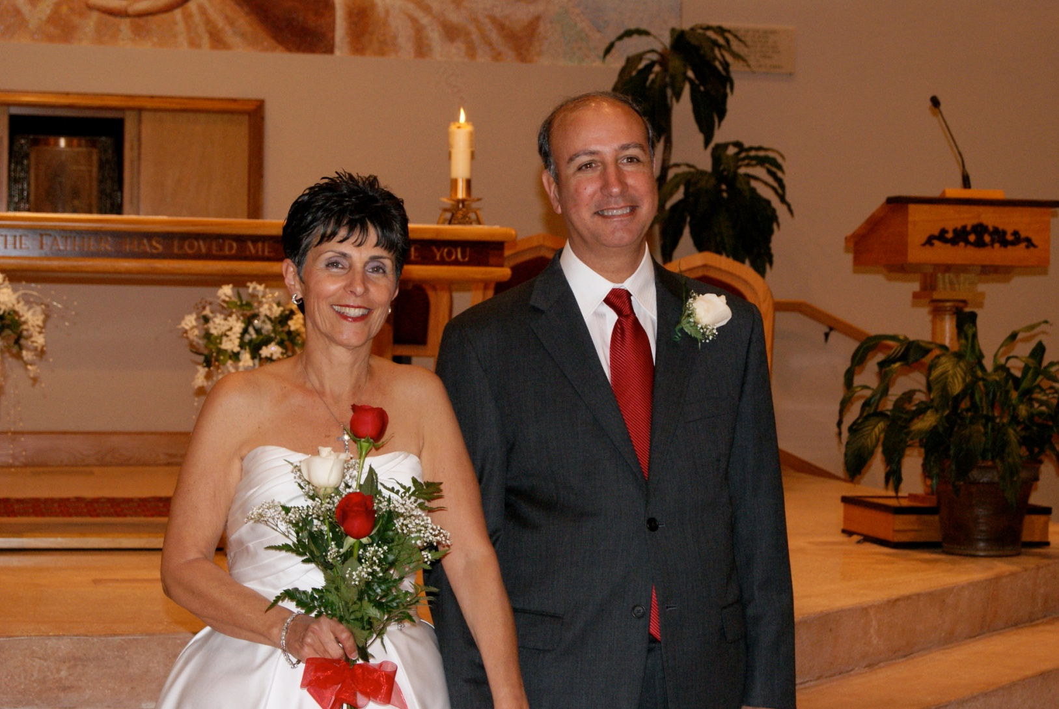
To What are You Saying “I DO”?

Slide 8
Exchange of Consent
Have you come here freely and without reservation to give yourselves to each other in marriage? R/ I have.
Will you love and honor each other as man and wife for the rest of your lives? R/ I will.
Will you accept children lovingly from God and bring them up according to the law of Christ and his Church? R/ I will.
I, ___ take you, ___ to be my wife/husband. I promise to be true to you in good times and in bad, in sickness and in health, I will love you and honor you all the days of my life.

Slide 9


What Makes a Marriage Valid
Shotgun Wedding?

Slide 10
Exchange of Consent
Have the proper capacity to exchange consent and do so:
Consent to what the Church intends by marriage, that is:
Freely = Free
Unconditionally = Total
Fidelity & Indissolubility = Faithful
Children = Fruitful

Slide 11
Sins Against Chastity
Lust is a “disordered desire for or an inordinate enjoyment of sexual pleasure,” especially when sought for itself (CCC, no. 2351).
Masturbation is sinful because it misuses the gift of sexuality in an inherently selfish act, devoid of love. It is a problem for which a counselor, spiritual director, or a confessor can be of considerable help. A person often needs assistance to understand the causes of this behavior, which are often habitual or in response to emotional stress or unexamined underlying attitudes.
Fornication (sexual intercourse between unmarried persons) is sinful because it violates the dignity of persons and the nuptial meaning and purpose of sexuality, which is ordered only to the unitive and procreative goals of married people.
Pornography (sexually explicit material) has become even more available through the Internet. This presents real difficulties for both individuals and society, as viewing pornography is not only sinful in itself but can also become an addiction and lead to dangerous sexual behaviors. It has also led to a greater exploitation of children as sexual objects.
Prostitution reduces the person “to an instrument of sexual pleasure,” an object to be used. It increases the spread of sexually transmitted diseases. To protect innocent members of society, prostitution can legitimately be forbidden by civil authority. It is more prevalent where a culture exploits the physical and social vulnerability of women (CCC, no. 2355).
Rape is an act of violence in which a person forces a sexual act on an unwilling partner. “Rape deeply wounds the respect, freedom, and physical and moral integrity to which every person has a right. . . . It is always an intrinsically evil act” (CCC, no. 2356).

Slide 12

The Tale of Two Brains Clip

Slide 13

The Joy of Sexual Honesty Within Marriage

Slide 14
Free: Sexual honesty does not engage in manipulation, coercion, violence, or force. It does not demand sex, nor succumb to lust or uncontrollable passions.

Slide 15
Faithful: Sexual honesty demands single-hearted devotion in thought, word, and deed. Pornography, extramarital sex, emotional infidelity, and fantasizing about other people (in or out of the bedroom) are all offenses against fidelity.
Fruitful: Sexual honesty requires couples to be open to receiving children from God through every act of sexual intercourse. Any act or method of sterilizing the sexual act, including masturbation and all forms of contraception, is contrary to sexual honesty.

Slide 16
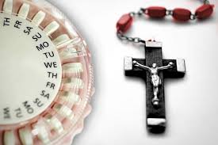
The Contradiction of Contraception

Slide 17

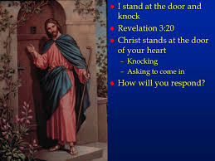
Total: Sexual honesty does not withhold anything (including one’s fertility), erect barriers, or create emotional distance. To love “totally” is to be vulnerable with one another, and to preserve the unitive and procreative aspects of sex; the husband achieves climax inside his wife, and tenderly provides for his wife’s climax within the sexual encounter.

